Slide 1
Deep Frequency Principle
许志钦
2023年10月7日

Slide 2
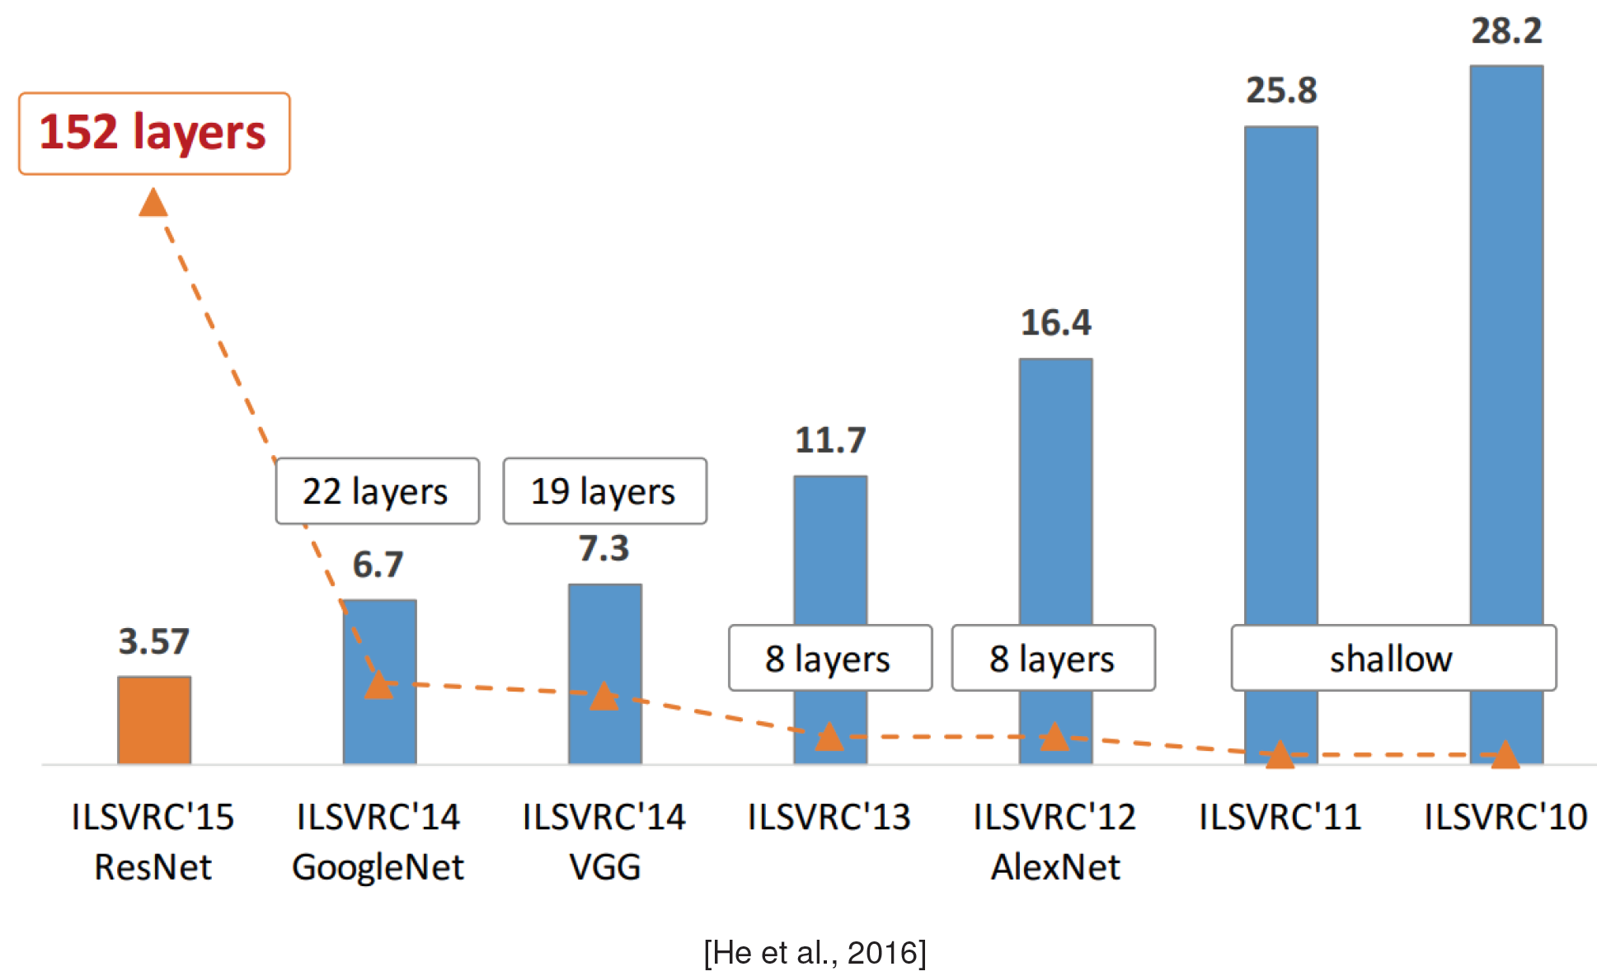
Depth effect: generalization and speed

Slide 3
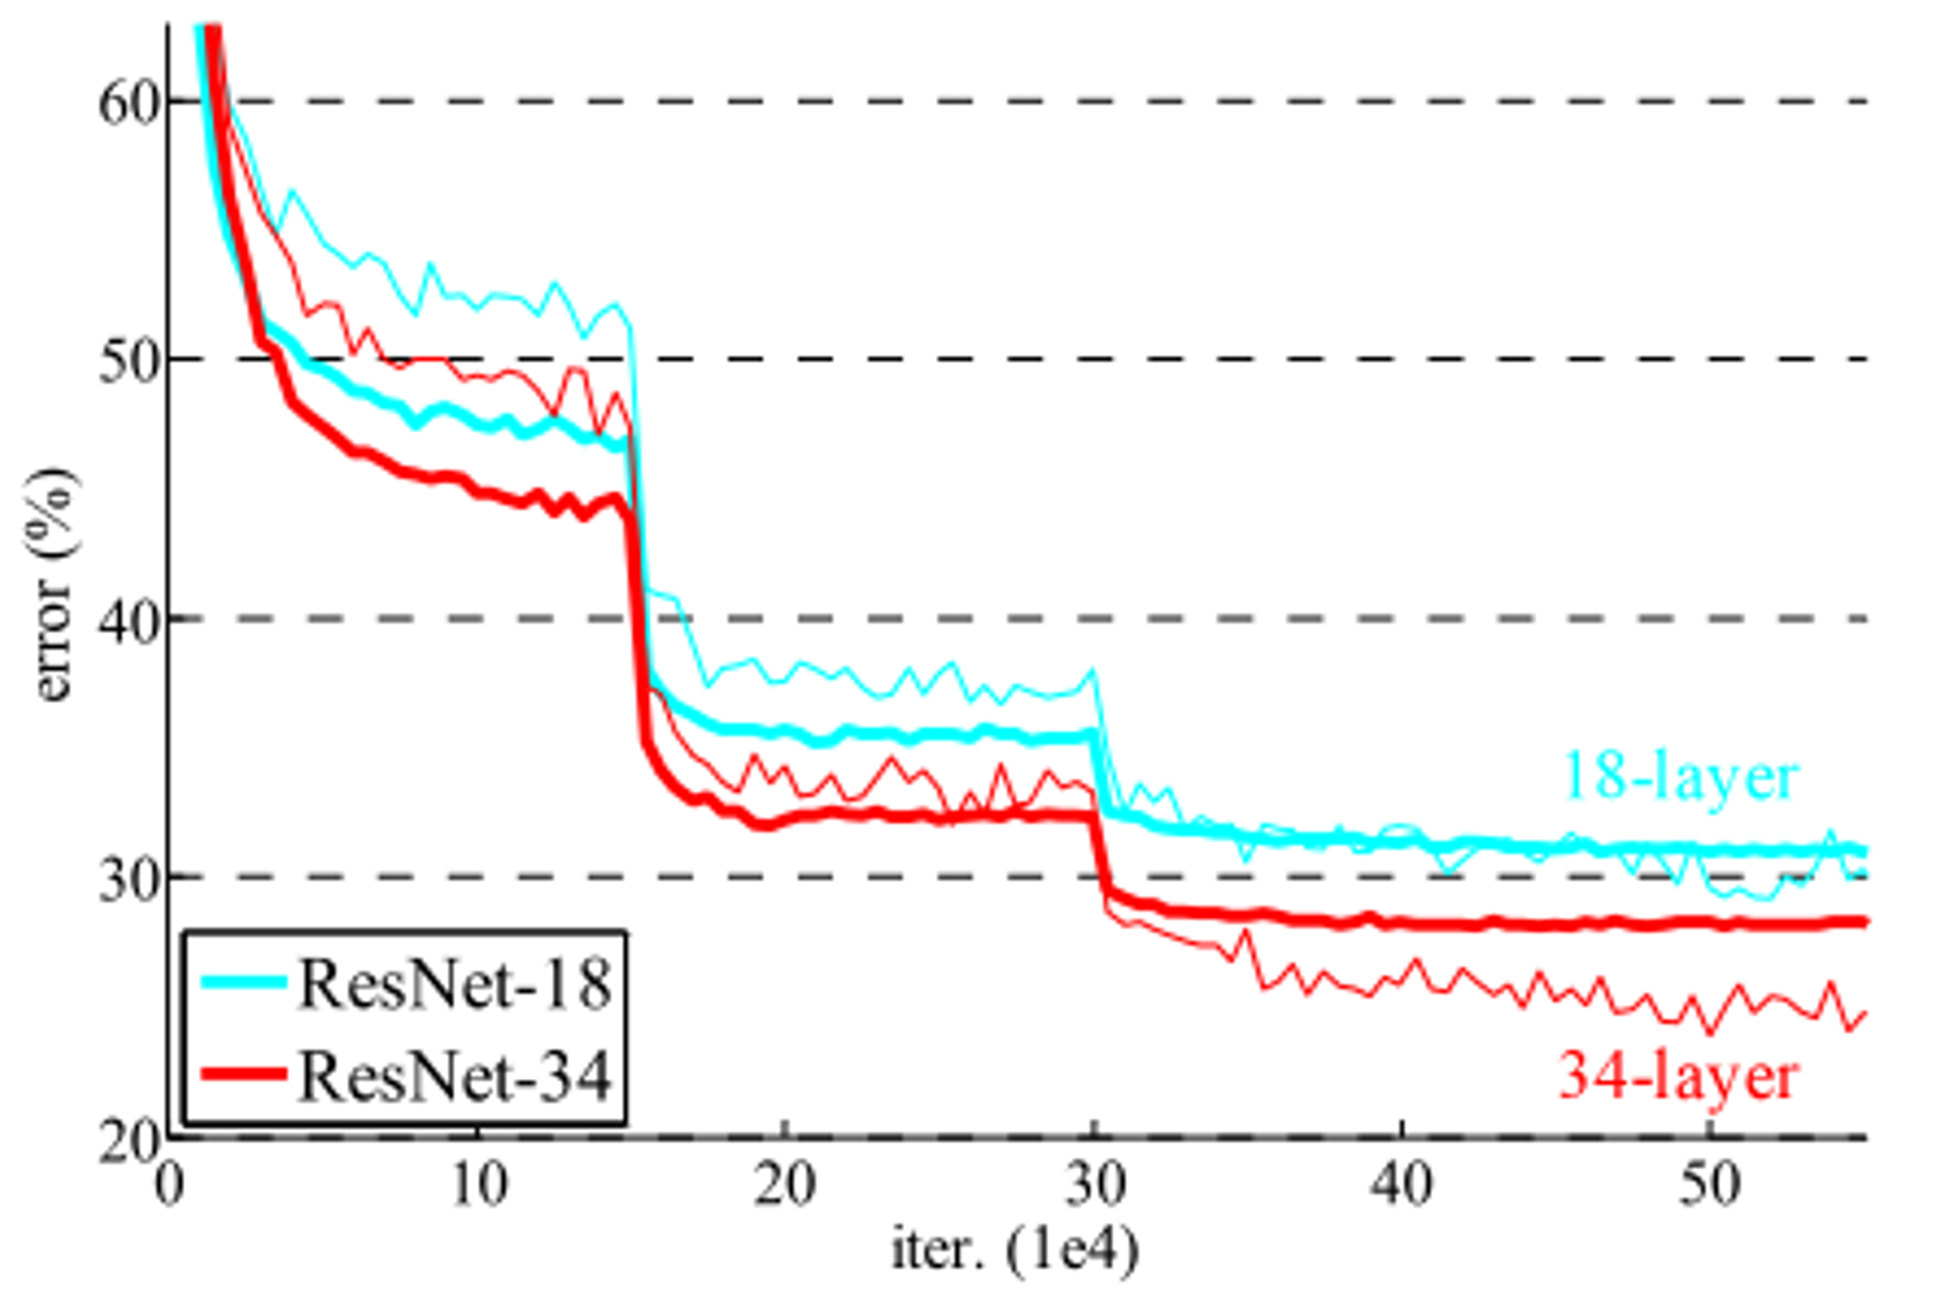
Depth effect: generalization and speed
Deep Residual Learning for Image Recognition, He et al., 2016

Slide 4
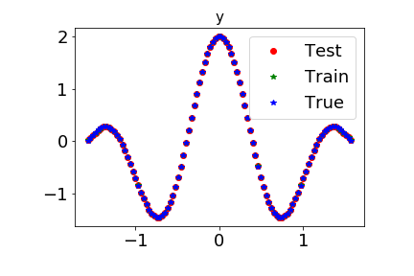
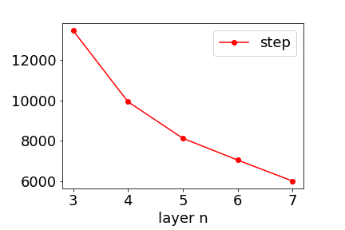
Toy Examples: Deeper faster
cos3x+cos5x
Target function
Step number to a fixed error
Each layer has 500 neurons
2007.14313

Slide 5
Related work
On the Optimization of Deep Networks: Implicit Acceleration by Overparameterization
Sanjeev Arora, Nadav Cohen, Elad Hazan (2018)
Linear network
depth acts as a preconditioner which may accelerate convergence.
The preconditioning can be seen an acceleration procedure that combines momentum with adaptive learning rates.

Slide 6
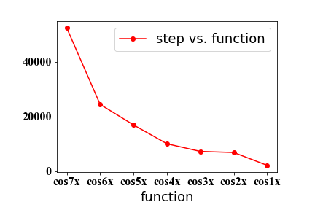
Recall: lower frequency, faster training
2007.14313

Slide 7
Conjecture
Deep frequency principle:
The effective target function for a deeper hidden layer is a lower frequency function.
Need a quantity
To characterize the frequency distribution of high-dimension functions
2007.14313

Slide 8
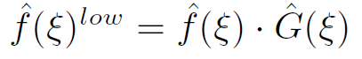
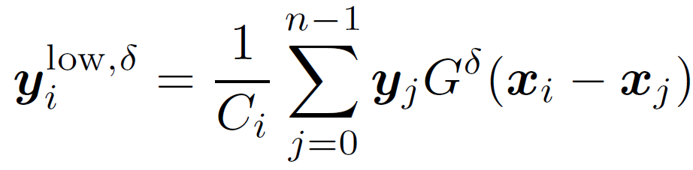
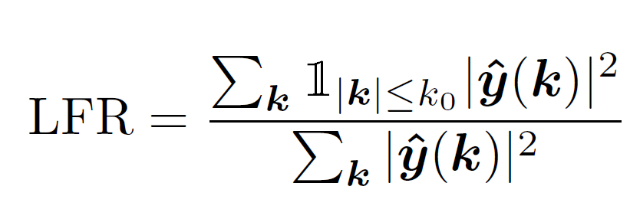
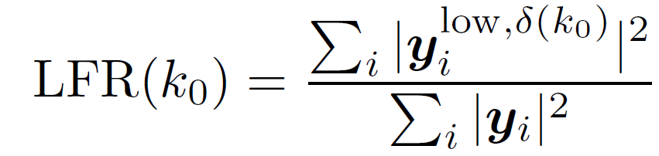
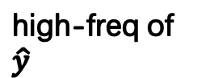
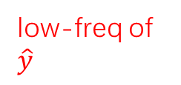
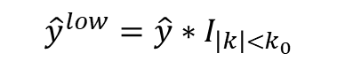
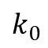
Low frequency ratio (LFR)
low-freq of $\hat{y}$
Product with an indicator function in Fourier space
high-freq of $\hat{y}$
$${\hat{y}}^{low}=\hat{y}∗I_{\left|k\right|<k_{0}}$$
$$k_{0}$$
Using Gaussian to approximate indicator function

Slide 9
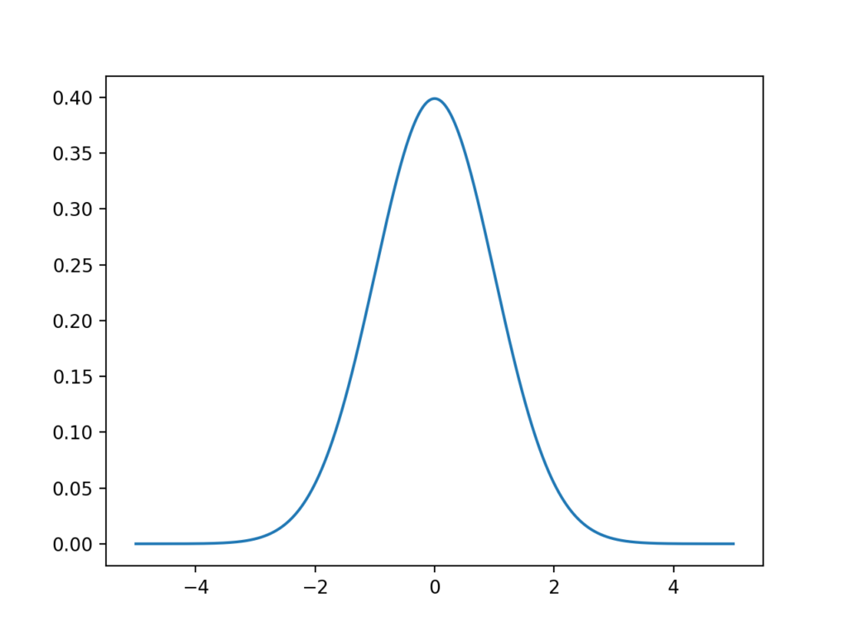

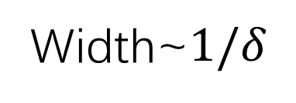
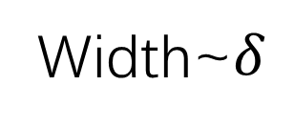

Low frequency ratio (LFR)
A bit more about Gaussian function
$$g\left(x\right)=\exp{−\frac{x^{2}}{2δ^{2}}}$$
Width~$δ$
$$\hat{G}\left(ξ\right)=∫g\left(x\right)e^{−iξx}dx$$
$$\hat{G}\left(ξ\right)=\exp{−\frac{δ^{2}ξ^{2}}{2}}$$
Width~$1/δ$

Slide 10
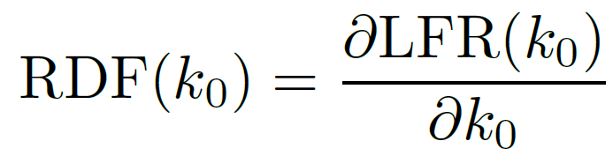
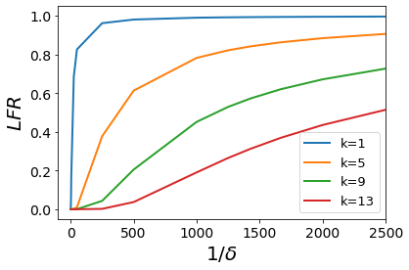
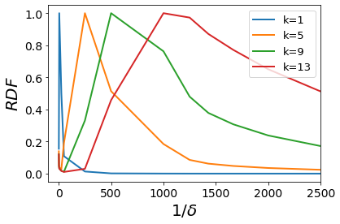

Ratio Distribution Function (RDF)
$$\sin{kπx}$$
2007.14313

Slide 11
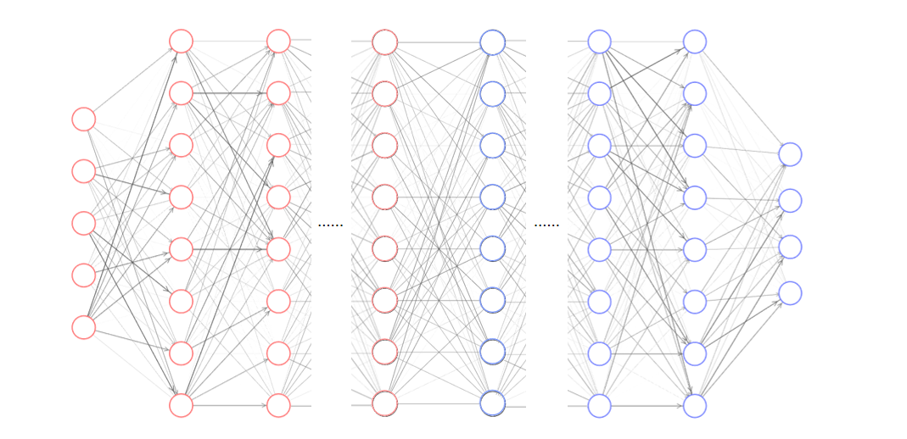
Effective target function
Deep frequency principle:
The effective target function for a deeper hidden layer is a lower frequency function.
When BP, the green layer’s effective input and the output
2007.14313

Slide 12
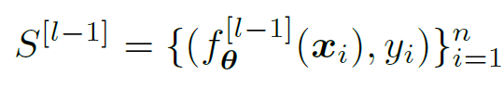
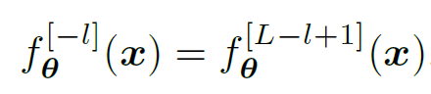
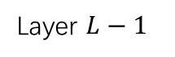

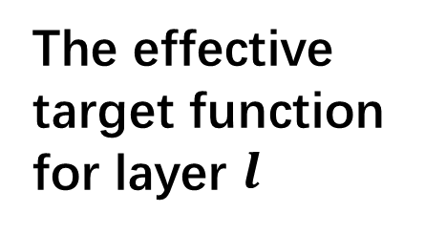
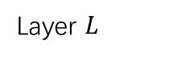
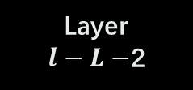

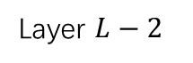
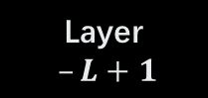
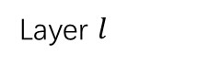

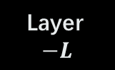
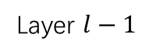

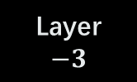
Effective target function
pre-condition component
learning component
Layer 0
Layer 1
Layer 2
Layer $l−1$
Layer $l$
Layer $L−2$
Layer $L−1$
Layer $L$
The effective target function
for layer $l$
2007.14313
Layer
$$−L−1$$
Layer
$$−L$$
Layer
$–L+1$
Layer
$l−L−$2
Layer
$l−L−1$
Layer
$$−3$$
Layer
$$−2$$
Layer
$$−1$$

Slide 13
Experiments on Resnet18
INPUT
Convolution layer
FC
FC
OUTPUT
Regarding
the last FC layer
as learning component
Exam the target function for the
Learning component
INPUT
Convolution layer
FC
FC
OUTPUT
The last two FC layers fixed.
2007.14313

Slide 14
Experiments on Resnet18
Regarding
the last FC layer
as learning component
Exam the target function for the
Learning component
The last two FC layers fixed.
2007.14313

Slide 15
Resnet18: Deeper, faster, better
2007.14313

Slide 16
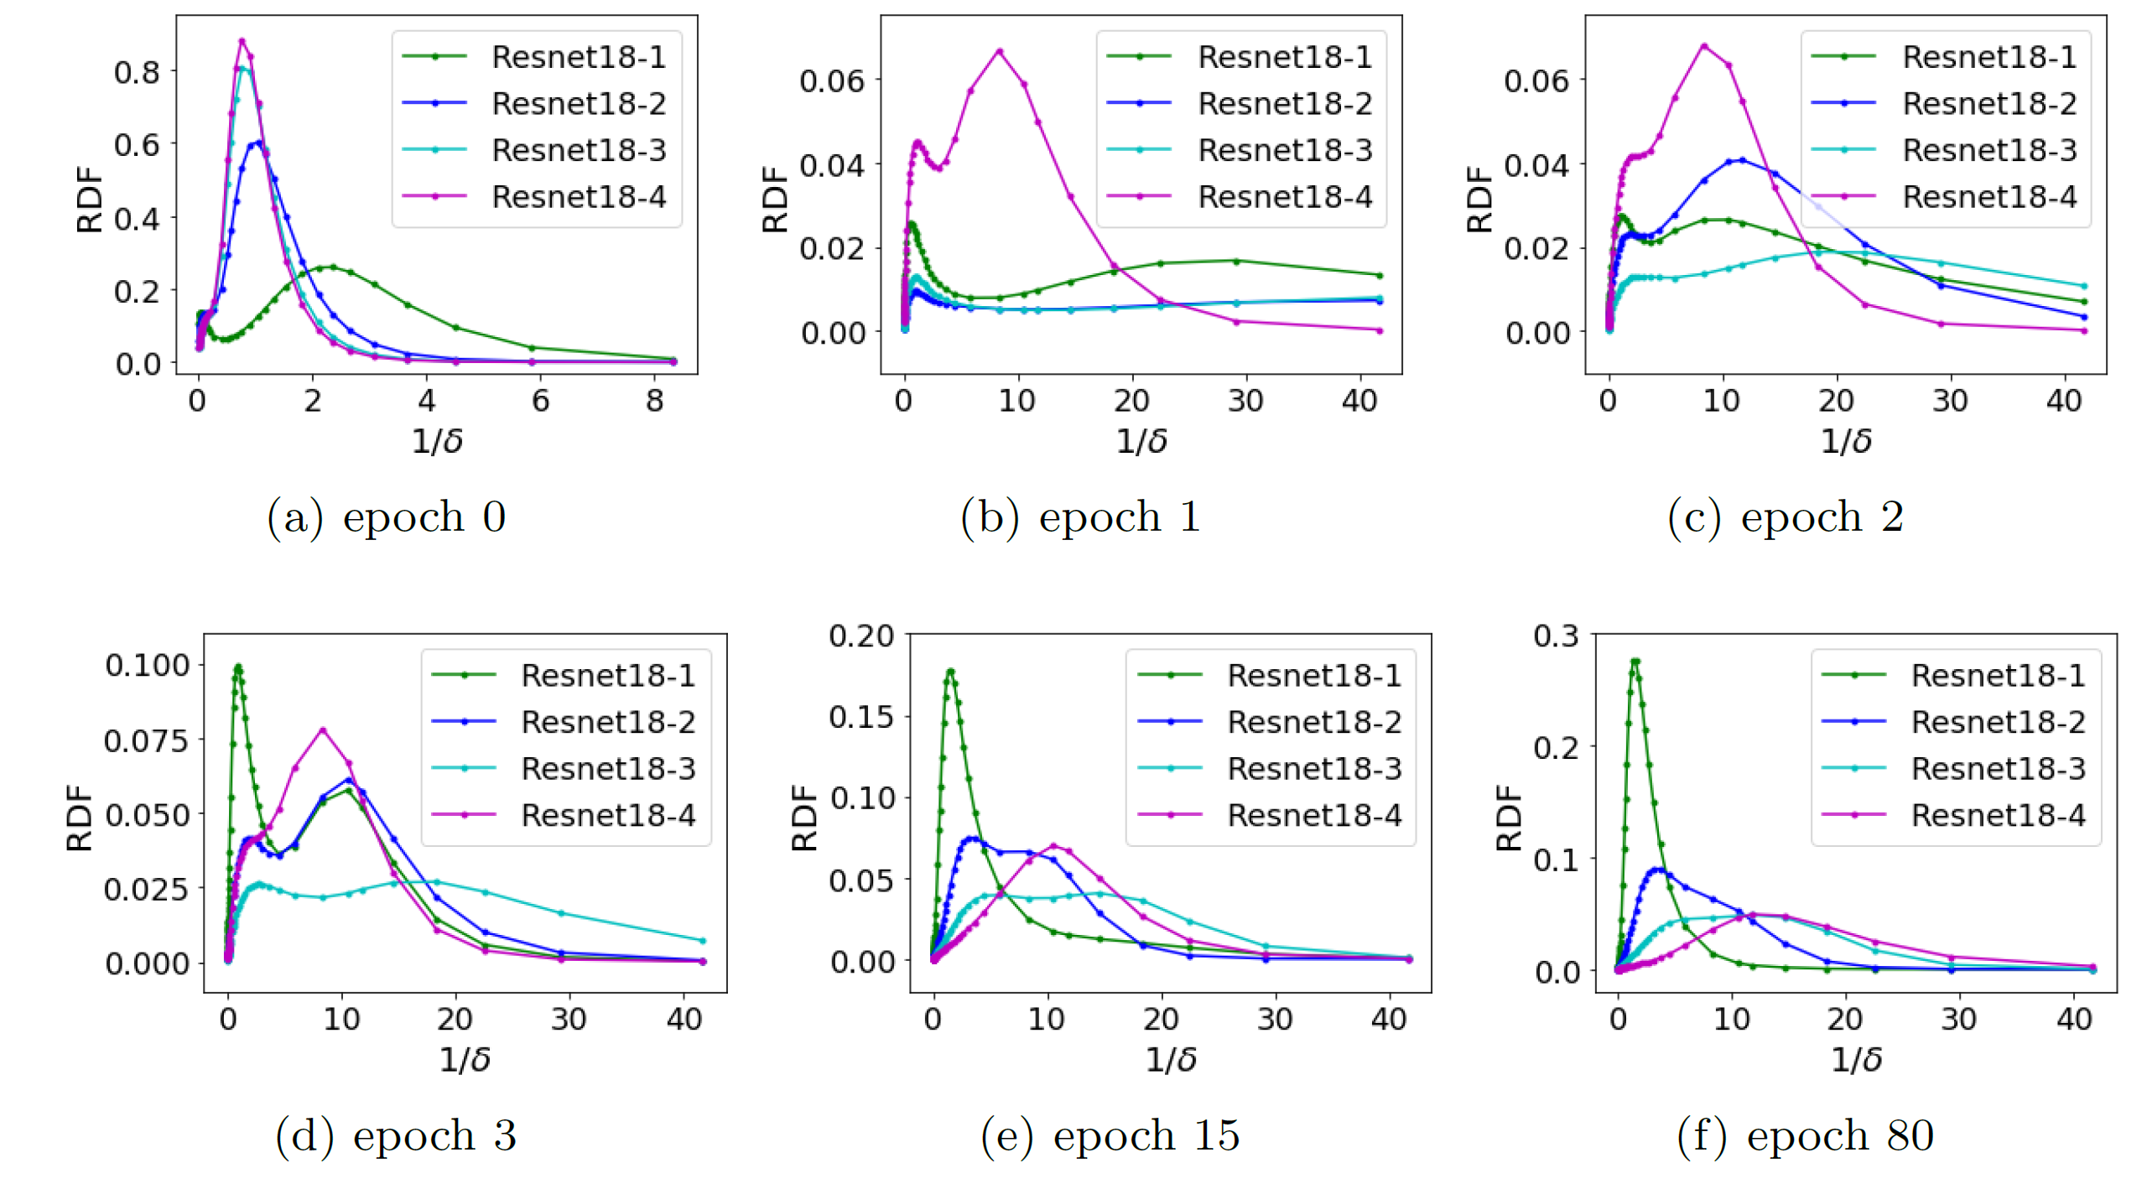
Resnet18: Deeper, stronger low-freq bias
Green: deepest
2007.14313

Slide 17
Analysis
Deep frequency principle:
The effective target function for a deeper hidden layer has a bias towards a function with more low frequency during the training.
Cross different network structures on resnet18
How about different layers in a network?
2007.14313

Slide 18
Deep frequency principle in one net
MNIST
Fully connected network
Consider a network
Consider the RDF of (hidden layer, true labels)
Deeper layers: target function with more low frequency after training
2007.14313

Slide 19
Effective target function
pre-condition component
learning component
Layer 0
Layer 1
Layer 2
Layer $l−1$
Layer $l$
Layer $L−2$
Layer $L−1$
Layer $L$
The effective target function
for layer $l$
2007.14313
Layer
$$−L−1$$
Layer
$$−L$$
Layer
$–L+1$
Layer
$l−L−$2
Layer
$l−L−1$
Layer
$$−3$$
Layer
$$−2$$
Layer
$$−1$$

Slide 20
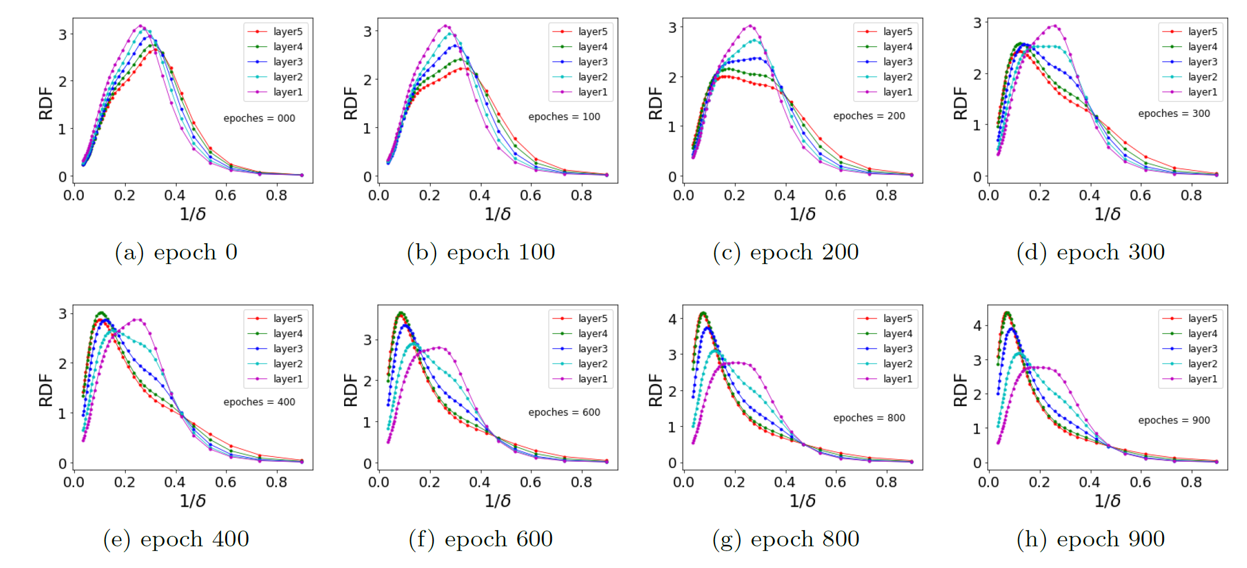
RDF of different hidden layers
2007.14313

